Slide 1
CHILDREN'S ANEMIA IN NIGERIA
Socioeconomic Status and Childhood Anemia
How mother's education and household wealth relate to a child's anemia risk (Data analysed from the 2018 Nigeria Demographic and Health Survey)
Data Analytics & AI Project | September 2026
Notes:
Welcome the audience and state the headline: this deck uses the 2018 Nigeria DHS to show how a mother's education and household wealth relate to whether her child is anemic. Two related questions, one story: socioeconomic disadvantage and child anemia.

Slide 2
Why This Matters
Anemia is one of Nigeria's most common and preventable child health problems
68.8%
10,182
36 + FCT
of children in the analytic sample were anemic to some degree
children with a valid hemoglobin-based anemia reading
states covered by this nationally representative survey
Anemia in early childhood is linked to impaired cognitive development, weaker immunity, and higher mortality risk.
Prevention programs (iron supplementation, bed nets, fortification) are costly to run everywhere at once.
Knowing which households carry the highest risk tells health agencies where to act first.
Children's Anemia in Nigeria (2018 NDHS)
2
Notes:
Anemia is common, costly to a child's development, and expensive to prevent everywhere at once. If risk concentrates in specific groups, prevention resources can be targeted more efficiently — that's the practical motivation for this analysis.

Slide 3
Data & Method
THE DATA
33,924 mother–child records; 10,182 with a valid child anemia reading (used for this analysis)
Outcome: Anemia level (Not anemic / Mild / Moderate / Severe), from hemoglobin adjusted for altitude (child-specific field)
Predictors: mother's education, household wealth quintile, urban/rural residence
METHOD
Group comparisons of % anemic by education, wealth, and residence
One supporting check: wealth × urban/rural stratification
Gaps are large and consistent across every group compared, not a one-off difference between two categories.
Association language only: cross-sectional data cannot establish causation.
DATA CLEANING
Two anemia fields exist for mother vs. child, the smoking-adjusted field is the mother's (smoking adjustment doesn't apply to kids), I used the true child field despite it being less complete (10,182 vs 13,136)
Kept duplicate rows and concentrated among untested children, not data errors.
Children's Anemia in Nigeria (2018 NDHS)
3
Notes:
Explain the sample: 33,924 total records, 13,136 with a usable anemia reading. Note the duplicate-variable decision briefly — we picked the more complete, child-relevant anemia field. Method is simple group comparisons plus one stratified check; results are associations, not proof of causation.

Slide 4
Nearly 7 in 10 Children Were Anemic
Overall anemia burden among children with a valid reading (n = 10,182)
68.8%
of children were anemic in some degree (mild, moderate, or severe)
31.2% not anemic
27.0% mildly anemic
38.6% moderately anemic
3.2% severely anemic
Children's Anemia in Nigeria (2018 NDHS)
4
Notes:
Almost 6 in 10 children in the analytic sample were anemic to some degree, and most anemic children fall in the mild-to-moderate range rather than severe. This sets the scale of the problem before looking at who is most affected.

Slide 5
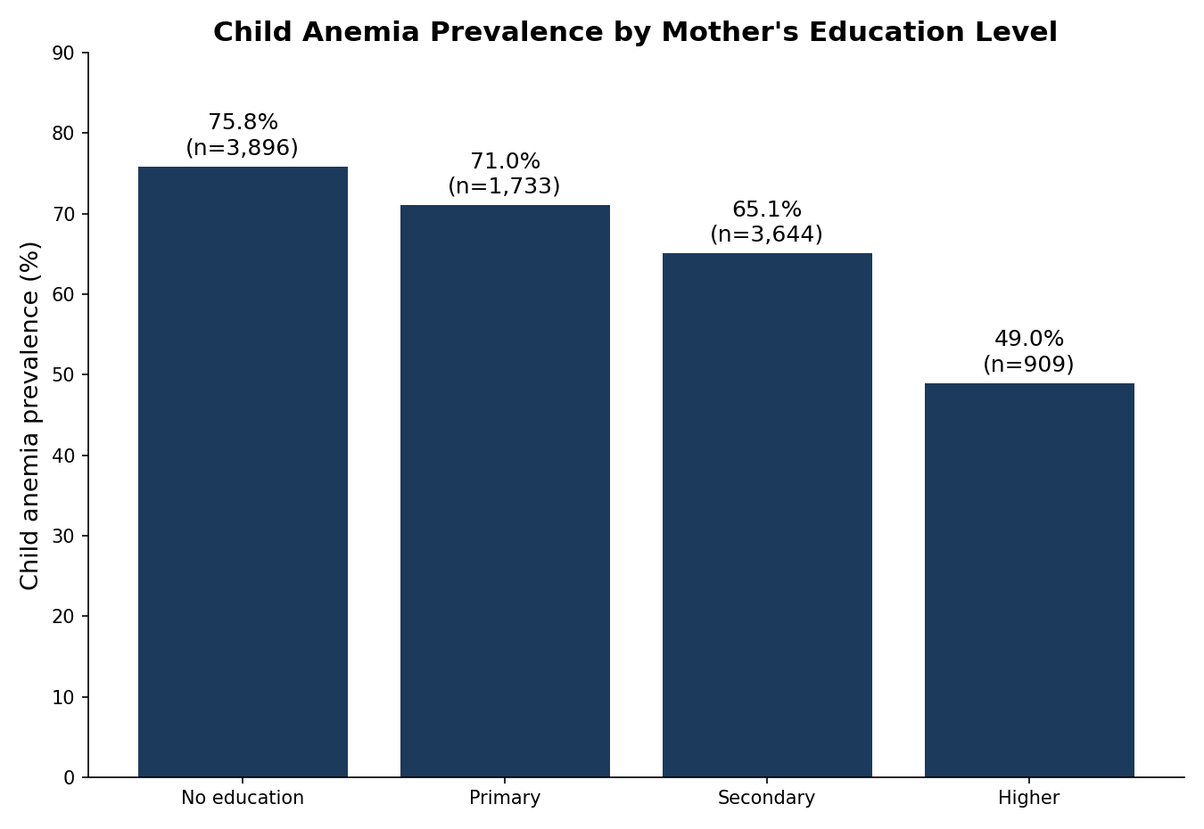
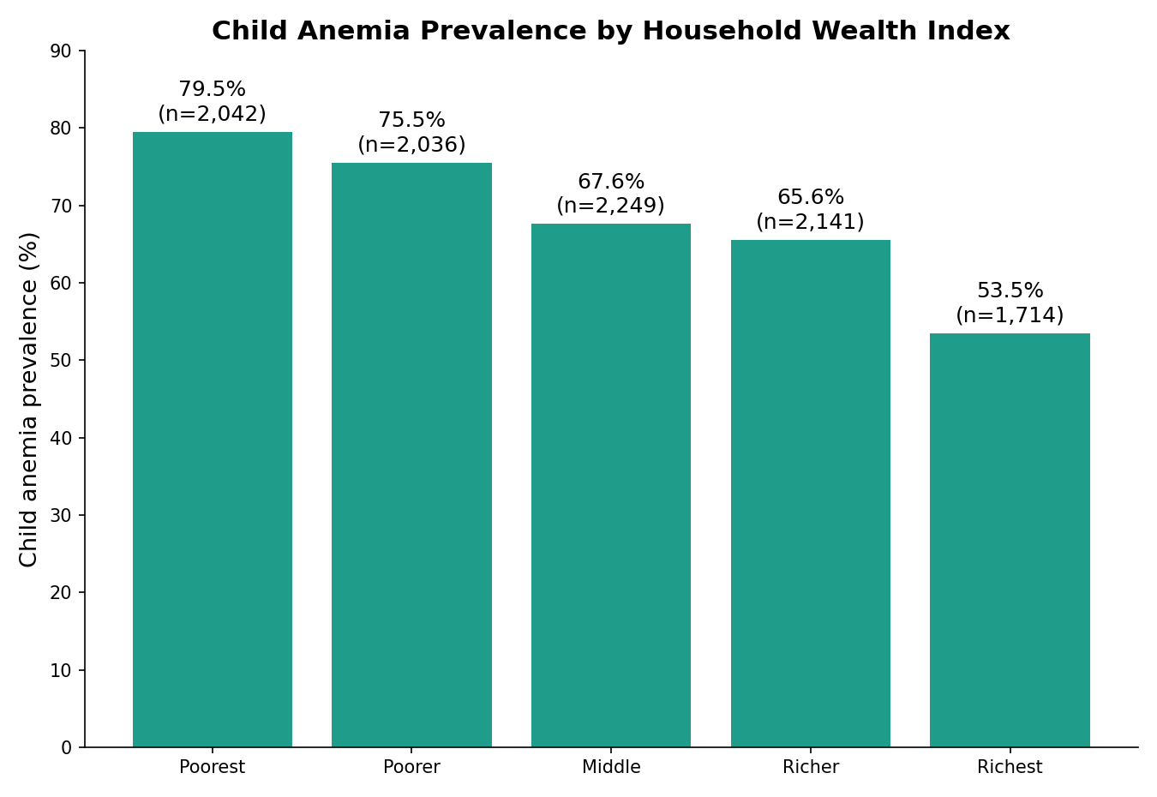
Anemia Tracks Household Disadvantage
Prevalence falls steadily as mother's education and household wealth rise
Education: 75.8% (no education) → 49.0% (higher education) a 26.8-point gap
Wealth: 79.5% (poorest) → 53.5% (richest) about 26-point gap, falling steadily across all 5 quintiles
Children's Anemia in Nigeria (2018 NDHS)
5
Notes:
This is the core finding: anemia prevalence declines steadily as mother's education rises, and separately as household wealth rises. Both gradients are roughly 16-18 percentage points from the lowest to the highest group, and both are statistically significant.

Slide 6
The Wealth Gap Holds in Both Urban and Rural Areas
Wealth × Residence: This analysis examines how household wealth and residence type interact to influence childhood anemia in Nigeria. The key finding is that both factors independently increase anemia risk, and their effects are consistent across different contexts. Although Child anemia is generally more prevalent in rural areas, with prevalence varying across wealth groups.
Rural: 72.9% anemic overall
Urban: 62.3% anemic overall
Richest rural children (58.6%) still exceed richest urban children (51.9%)
Children's Anemia in Nigeria (2018 NDHS)
6
Notes:
As a check, we split the wealth comparison by urban and rural residence. The wealth gradient holds in both settings, but rural children remain worse off at every wealth level — even the richest rural children have higher anemia rates than the richest urban children.

Slide 7
Discussion & Limitations of Findings
DISCUSSION
Children in Nigeria do not all face the same anemia risk, it's much higher for kids whose mothers are less educated, poorer, or live in rural areas.
The pattern is strong and consistent across 10,182 children, enough to guide where prevention goes first.
This survey alone can't prove which factor (income, diet, healthcare access, education) is doing the causal work.
LIMITATIONS
70% of children in the dataset had no valid anemia result recorded. We don't know whether that's because they were never tested, the test failed, or the data was simply not entered. This is a large gap.
Two anemia fields existed for mother vs. child: resolved using DHS field definitions, not guesswork.
The comparisons don't control for overlapping factors. For example, poorer mothers are also more likely to be less educated and rural, so we can't yet say which one is doing the heavier lifting.
Children's Anemia in Nigeria (2018 NDHS)
7
Notes:
Bring it together: anemia risk clusters among less-educated, poorer, and rural households. This is a strong enough, large enough pattern to guide where prevention programs are targeted first, while being honest that this data alone can't isolate which specific factor is causing the effect.

Slide 8
Recommendation & Conclusion
RECOMMENDATION
Poorest families should come first, their kids have the highest anemia risk (79.5%), so free iron drops and fortified food should reach them before anyone else. Rural areas need more health workers too, since rural children stay more anemic than city children even at the same income level - something about distance to care is adding risk on its own. Because malaria is a known driver of anemia and hits these same poor, rural communities hardest, stronger malaria control there would help on both fronts. Mothers don't need a new program to learn about iron-rich foods, that guidance can just be added to checkups and vaccine visits they already attend. And bed net distribution to less-educated, rural households effort should continue, not shrink.
CONCLUSION
A clear socioeconomic gradient in childhood anemia: prevalence falls steadily as maternal education, household wealth rise, and rural children remain more exposed at every wealth level. Targeting anemia-prevention programs toward low-wealth, low-education, and rural households is where impact per child reached is highest.
Children's Anemia in Nigeria (2018 NDHS)
8
Notes:
Close with limitations — this is cross-sectional survey data with some missingness and an unresolved duplicate variable — and the practical takeaway: prioritize iron supplementation, bed nets, and nutrition education in low-wealth, low-education, and rural communities for the greatest expected impact per child reached.

